Slide 1
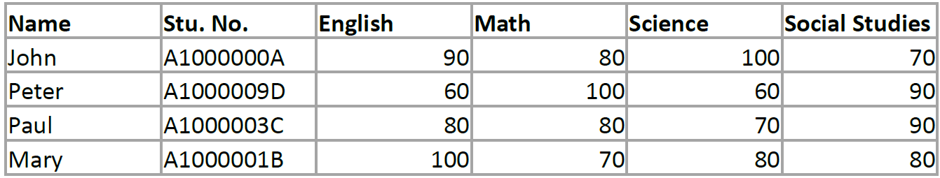
Student Particulars

Slide 2
How to convert all these table information into something a compiler can read and store?
Constants?
Variables?
Arrays?
Vectors?
Maps?

Slide 3
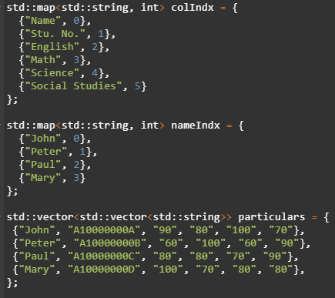
This is one way we could store the results in an Array. *Note: List is non-exhaustive and is for demonstration purposes only!!

Slide 4
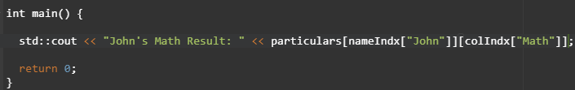
Obtaining the Results that we want

Slide 5
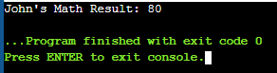
Sure it works, but…?
Clunky
Error-prone, especially with C++ as the syntax is SUPER confusing

Slide 6
Classes
Before moving on to Tetris

Slide 7

Classes
C++ is an object-oriented programming language.
It heavily associates with classes and objects, along with its attributes and methods.

Slide 8
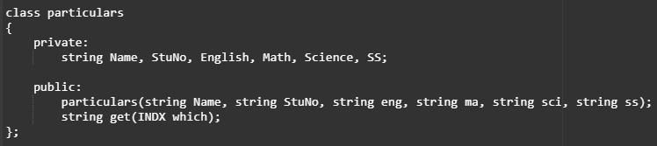
E.g. Particulars class
Used to store items (private) when constructed.

Slide 9
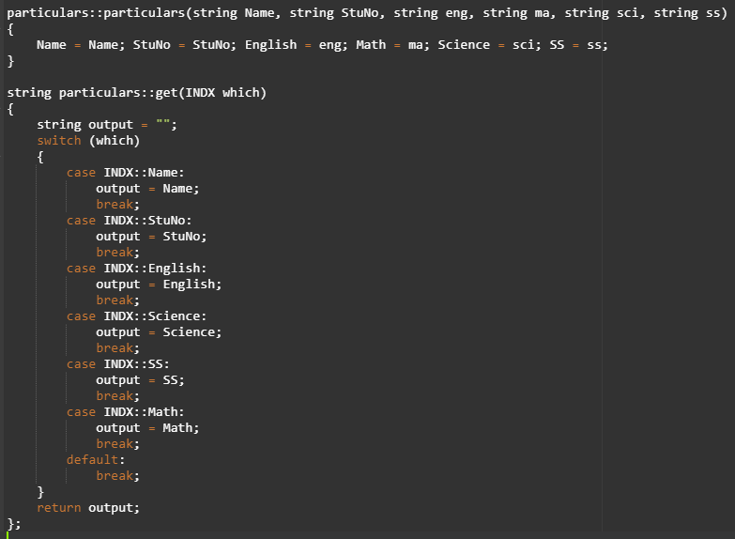
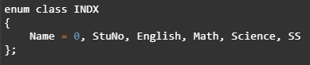
The functions in-depth

Slide 10
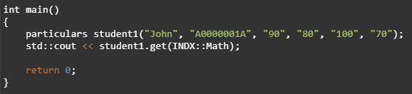
Instantiating student John and getting his scores

Slide 11
Game States
Moving into Game Creation now yay :D

Slide 12
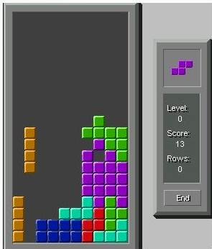
Tetris-simplified
Goal of Tetris is to survive as long as possible.
There will be tiles (called Tetrinos) and they will fall from the top of the screen.
If you complete a line, the tiles would disappear.

Slide 13
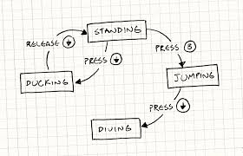
What are Game States?
The "game state" is simply a snapshot of the game. The "game state" changes if any of the objects or values in the game changes. E.g. life values, info is revealed, cards moving zones, counters on objects changing, etc

Slide 14

Our States
MENU
State
PLAY
State
GAME OVER
State

Slide 15
NO
Start
Game Over?
YES
GAME OVER State
Play?
Retry?
PLAY State
YES
MENU State
YES
NO
End
NO

Slide 16
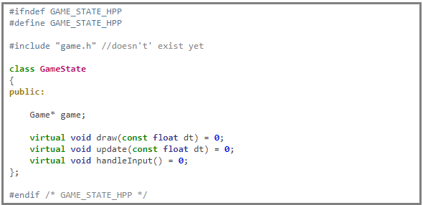
Creating an Abstract Class
It is sort of like a “base class”.
Other classes can inherit from this class (Polymorphinism)
The keyword “virtual” and equating these functions to 0 makes the class abstract.
Abstract means that the class could not be instantiated, but it can be pointed to using pointers.
GameState obj;
GameState* obj;

